Slide 1


Slide 2
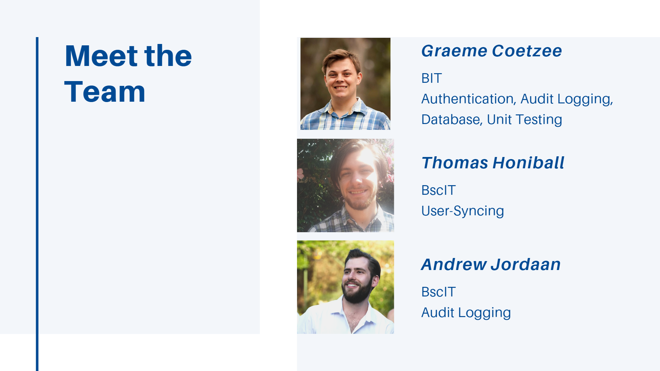

Slide 3
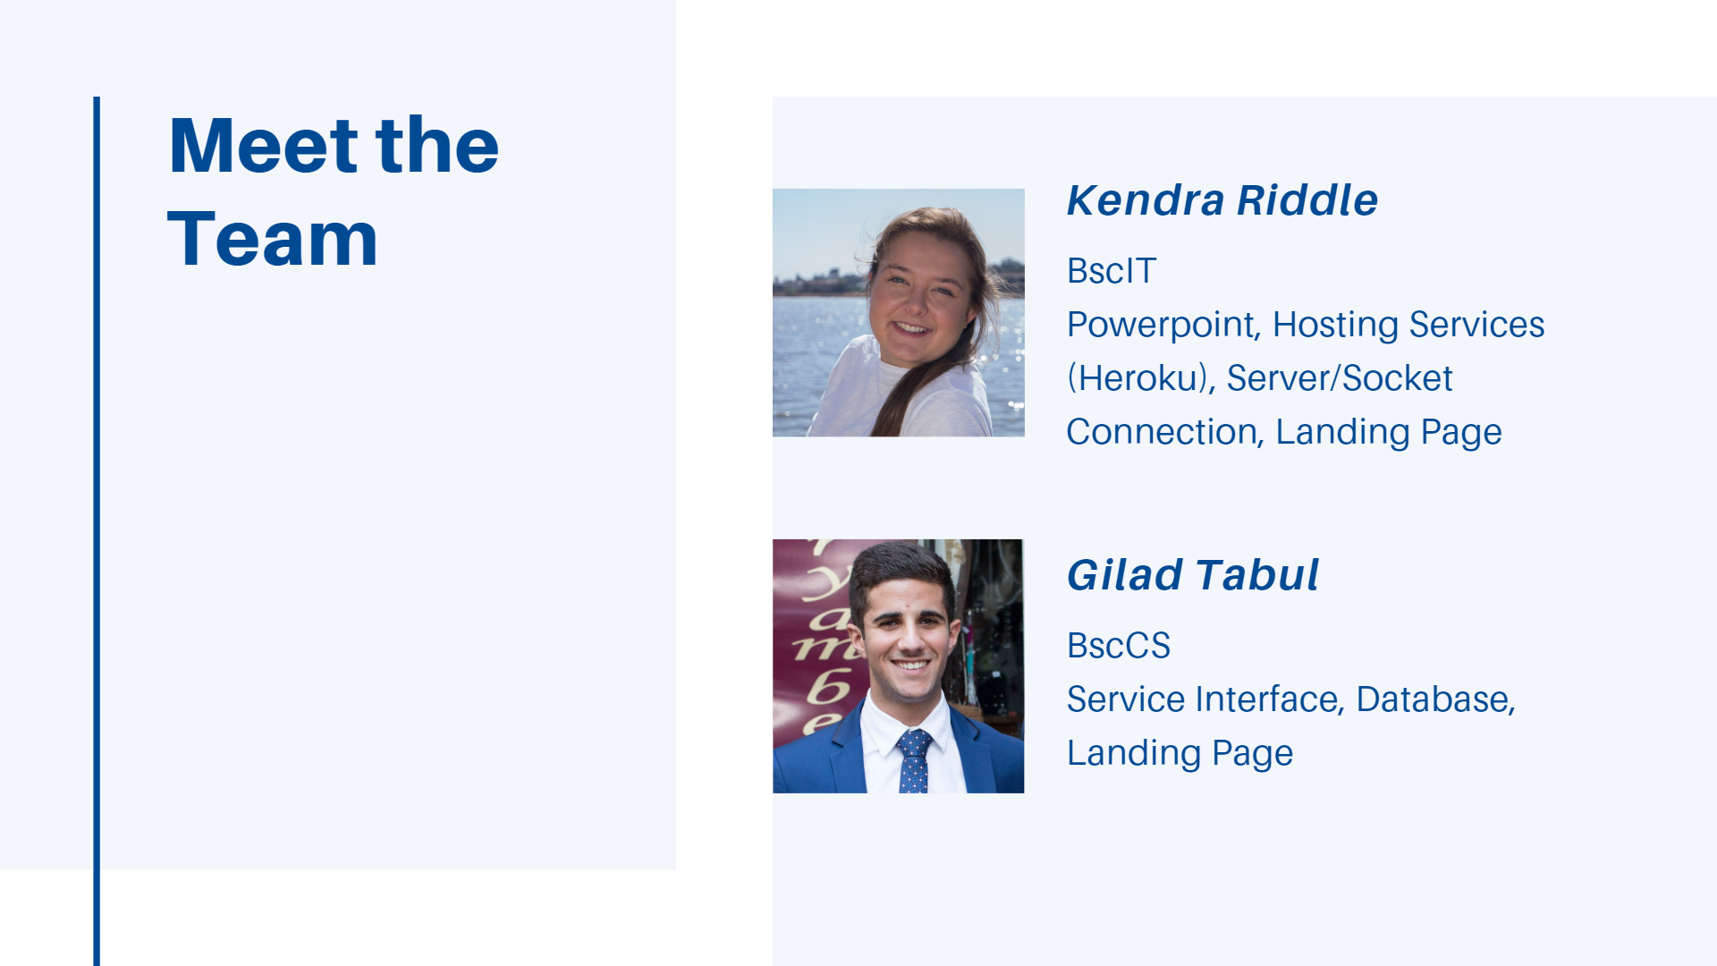

Slide 4
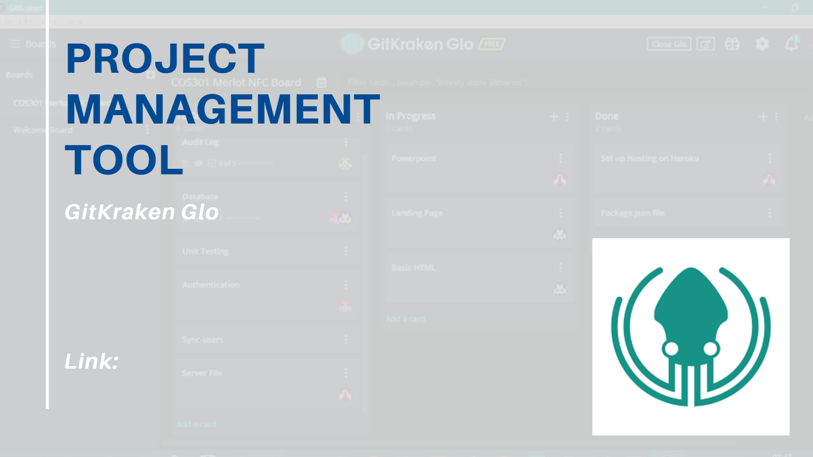
https://app.gitkraken.com/glo/board/XIkLh8aIEAAP9nlL

Slide 5

https://dashboard.heroku.com/apps/boiling-reef-24290

Slide 6

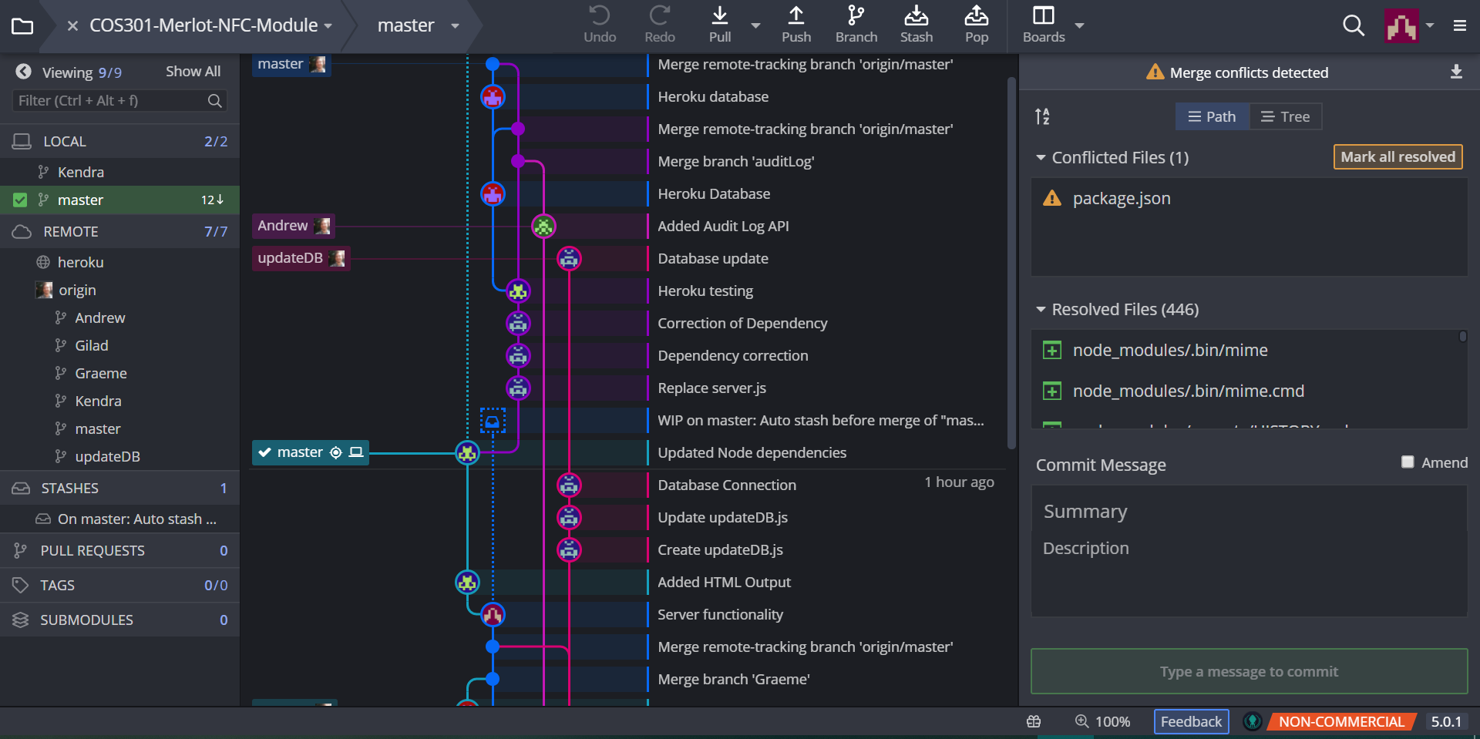

Slide 7
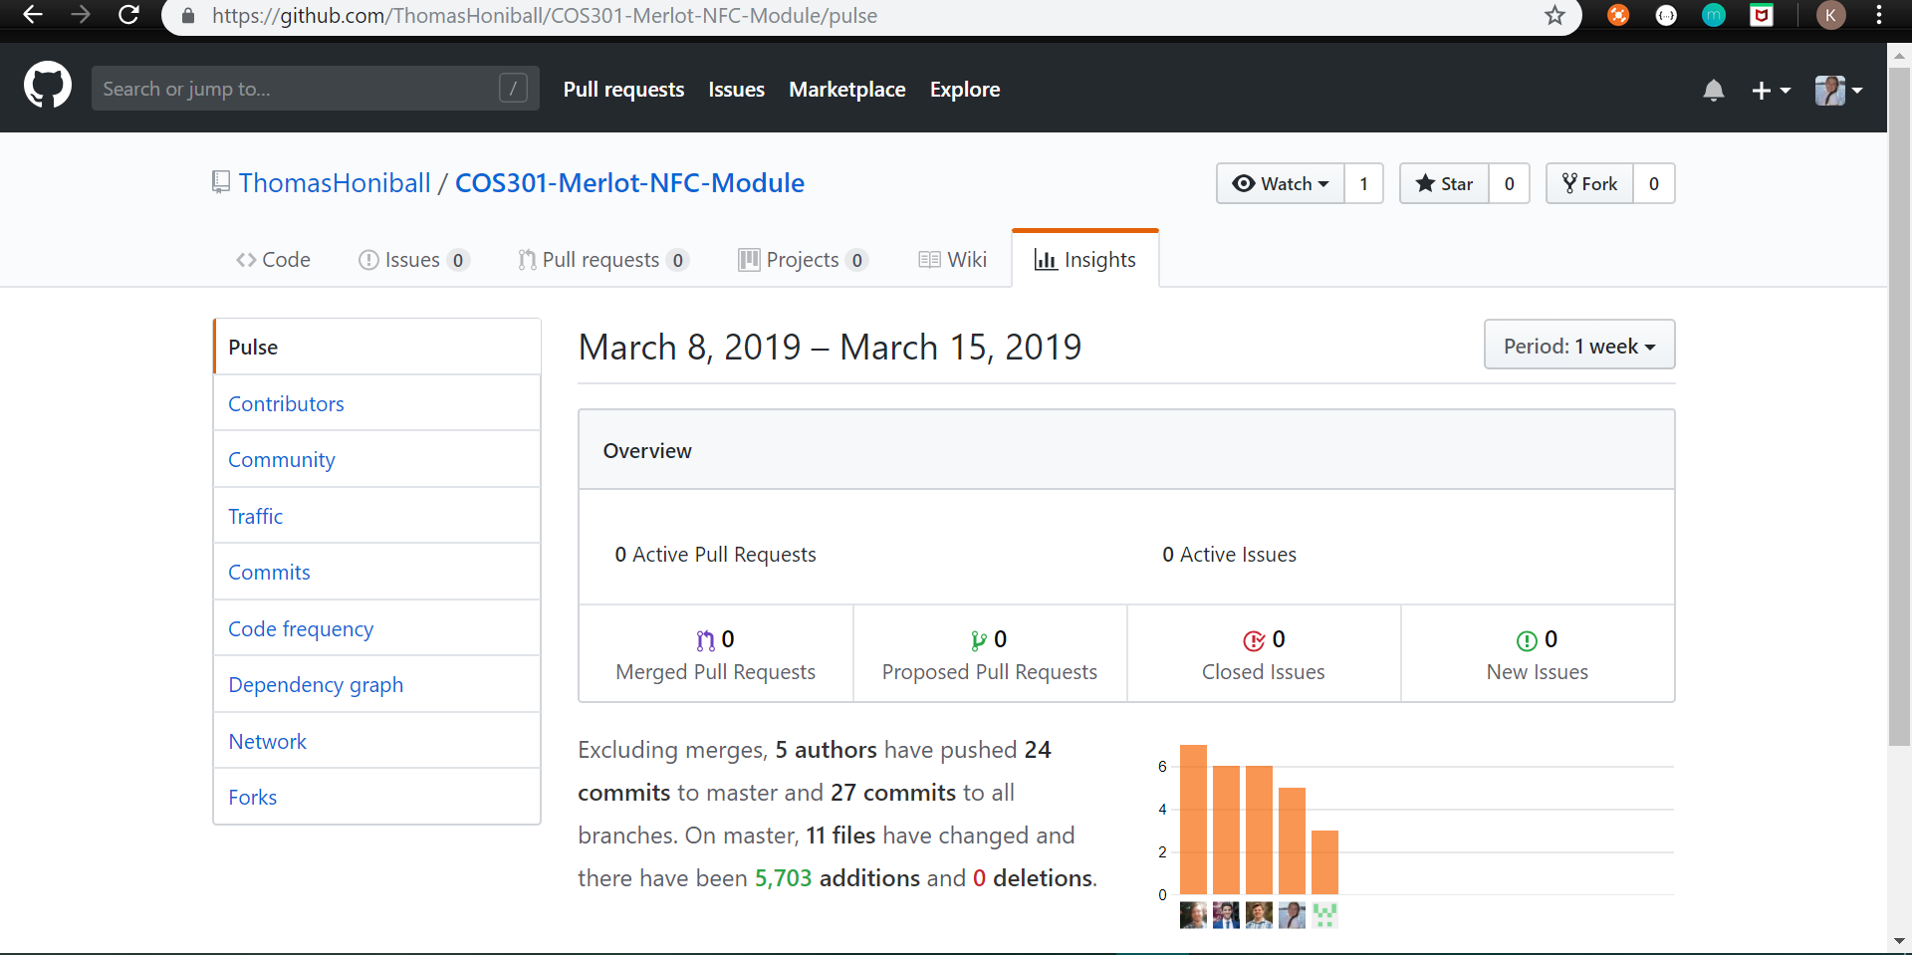

Slide 8
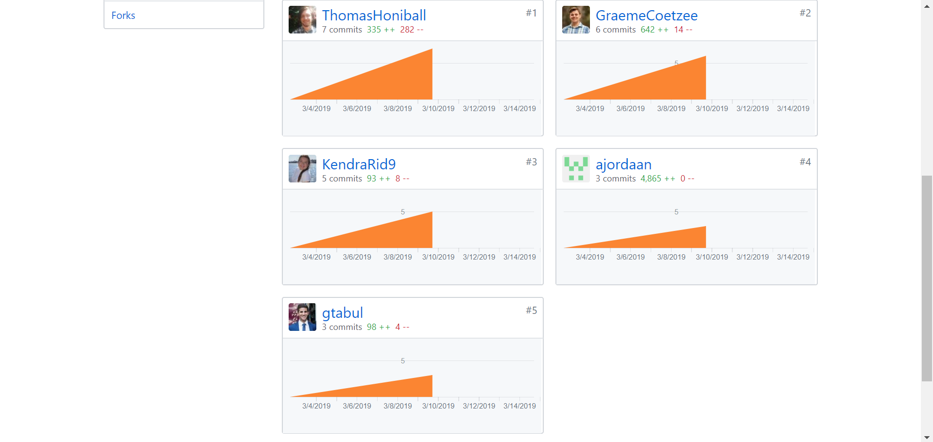

Slide 9
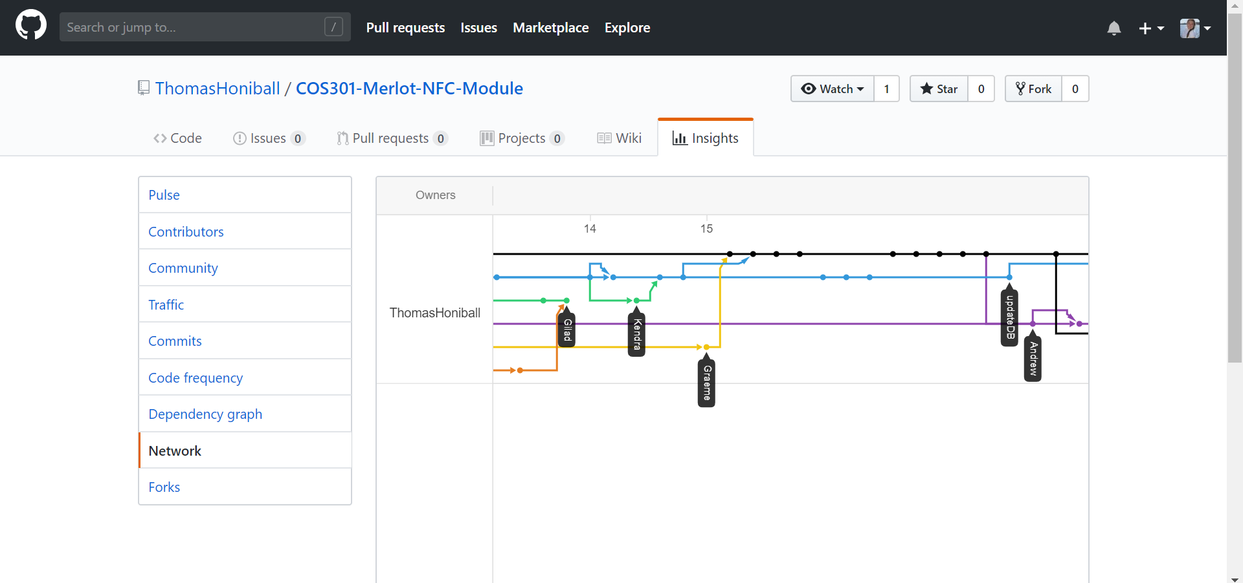

Slide 10
